Slide 1
PICAP Design review
Brendan Bickford

Slide 2
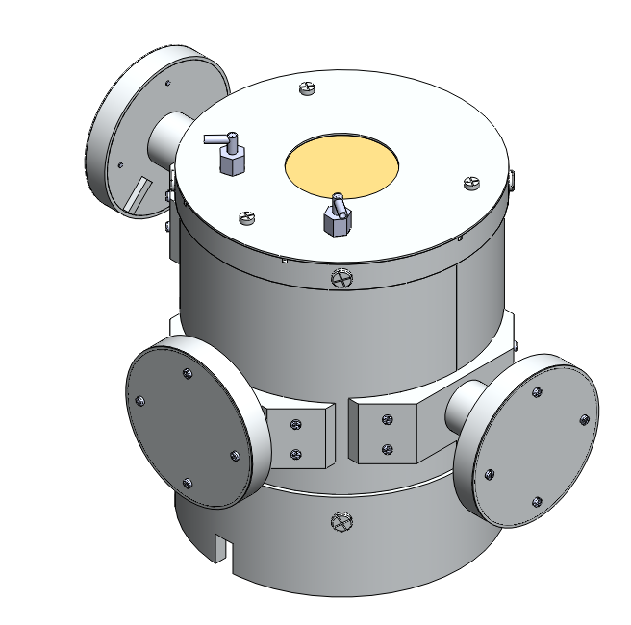
Outline
Advisors
Background
Design specifications
Concept Instrumentation
Design Assemblies

Slide 3
Advisors
Advisors:
Dr. May-Win Thein
Dr. James Connell
Dr. Clifford Lopate
Grad student:
Dan Tran

Slide 4
Background
Positron Identification by Coincidental Annihilation Photons
New design for detecting and distinguishing energetic particles (positions & negatrons)
Project goal: Build and test a proof of principle prototype telescope

Slide 5
Design Criteria and constrains
Minimize mass within design constraints
Specific placement and size for solid state detectors and scintillation material
Provide efficient particle detection (structure limitations)
Provide a working proof of principle prototype for this new detection method
- This means
Faraday cage required
Eliminate cross talk between scintillators
Exclude light
Purge ports for solid state detectors

Slide 6
Flight vs. Prototype
Conductive epoxy simple pieces rather then hog complex pieces from stock
Custom off the self parts
Minimize weight within budget, knowing this could be reproduced with less weight but at higher cost

Slide 7
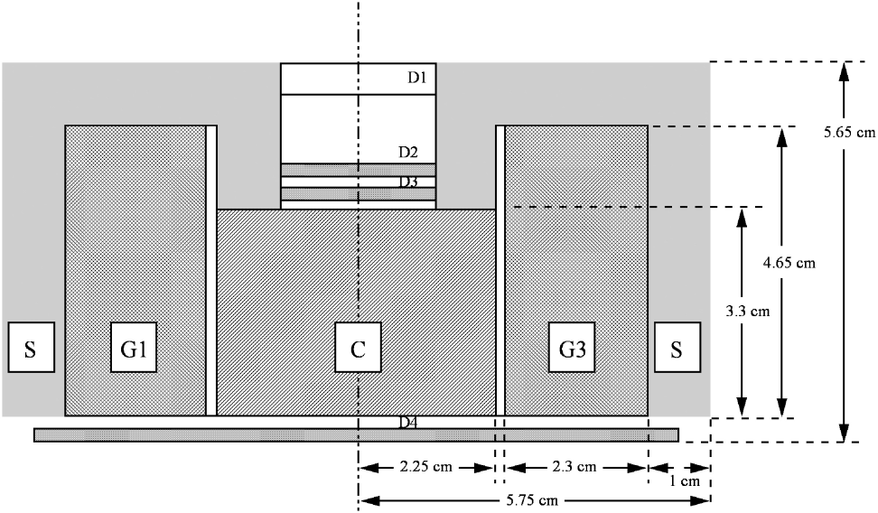
Instrument concept
Cross section view of proposed design
C- Plastic scintillation material
G- Heavy scintillation material
D- Solid state detectors
S- Plastic scintillation material

Slide 8
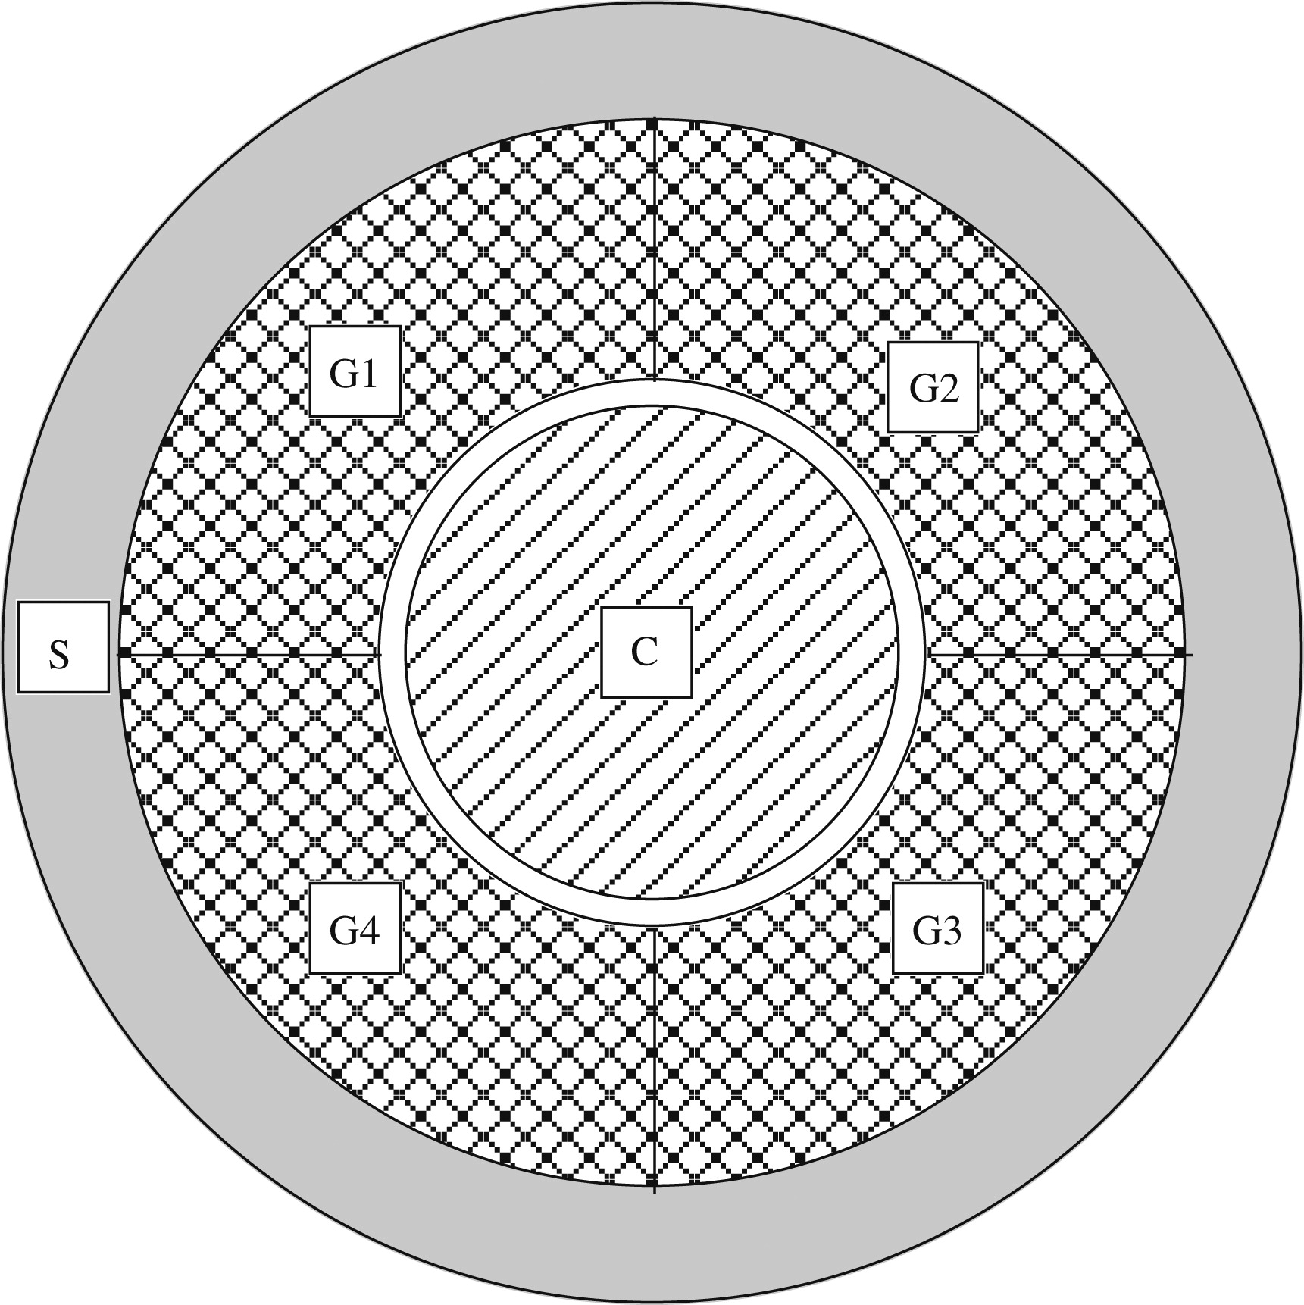
Instrument concept
Top view proposed design
C- Plastic scintillation material
G- Heavy scintillation material
D- Solid state detectors
S- Plastic scintillation material

Slide 9
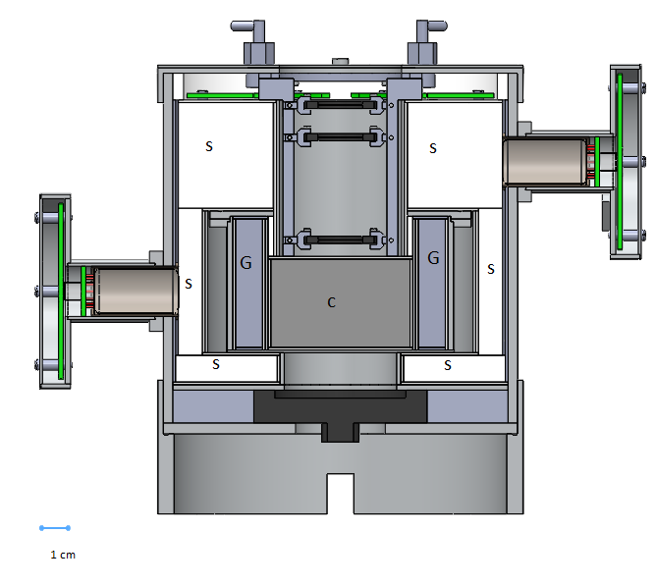
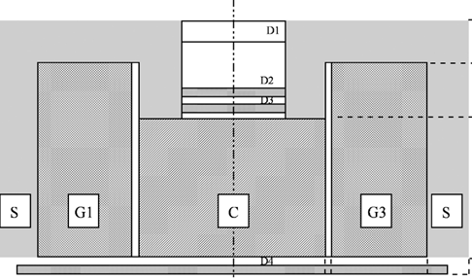
Concept vs. Design
Cross section view
C- Plastic scintillation material
G- Heavy scintillation material
D- Solid state detectors
S- Plastic scintillation material

Slide 10
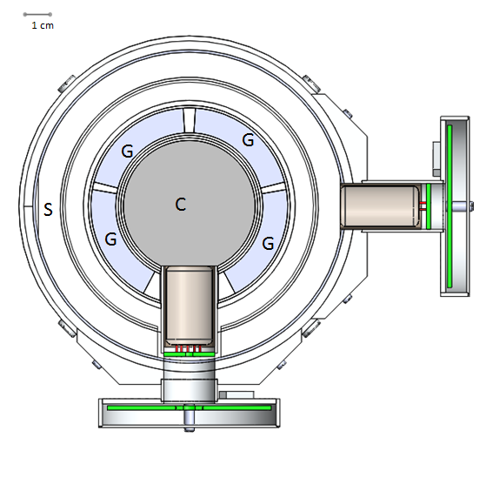
Concept vs. Final design
C- Plastic scintillation material
G- Heavy scintillation material
D- Solid state detectors
S- Plastic scintillation material

Slide 11
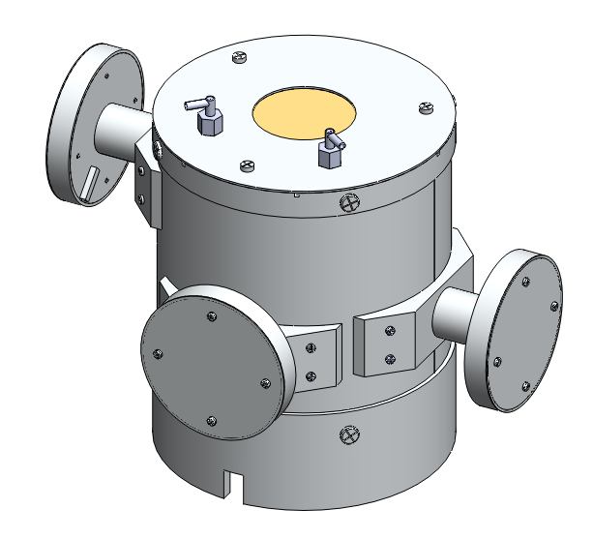
Dimensions
Total Height | 16.78 cm
Total width | 22.47 cm
Total mass | 3.3 kg
Total Volume | 1985 cm^2

Slide 12
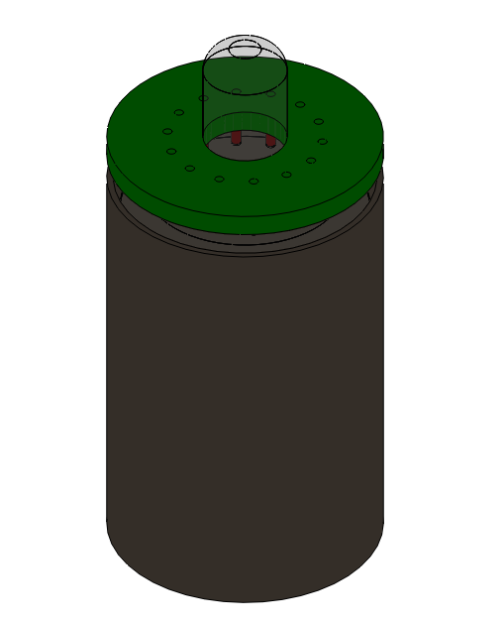
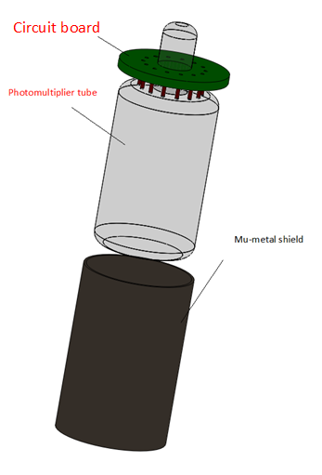
Photomultiplier tube assembly
Red- Active components
Blue- Teflon
Black- Other

Slide 13
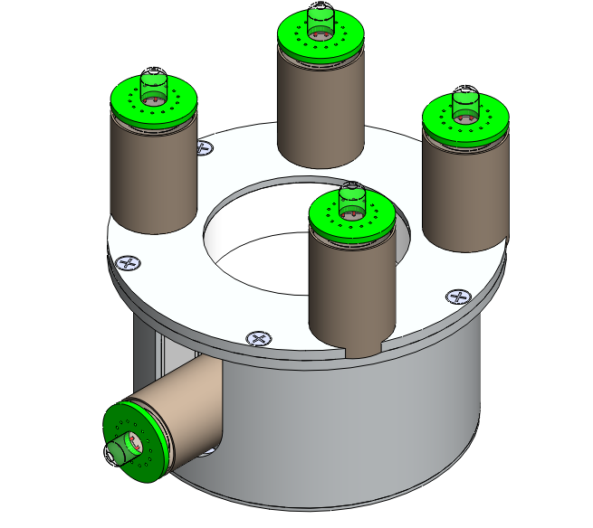
Scintillator assembly

Slide 14
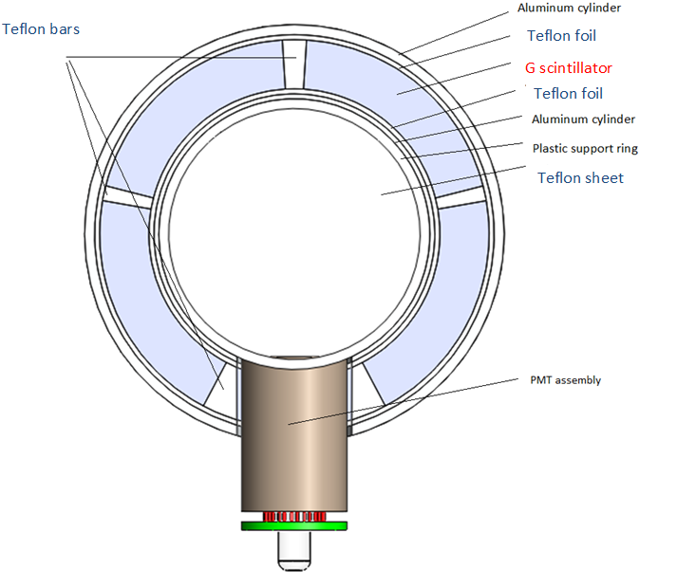
Scintillator assembly - top view cross section

Slide 15
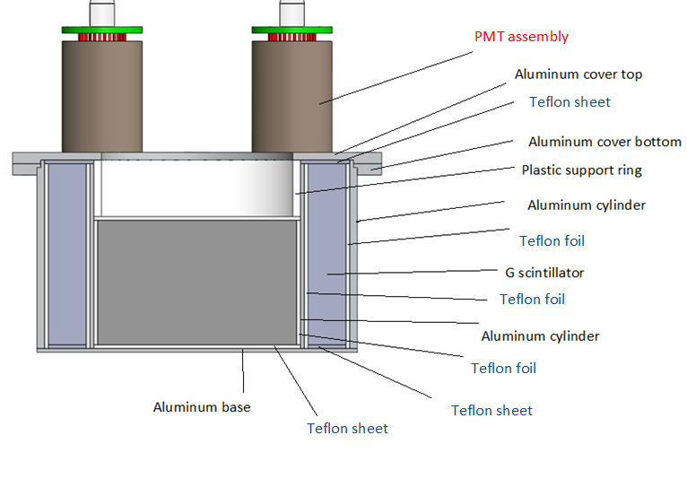
Scintillator assembly - center cross section

Slide 16
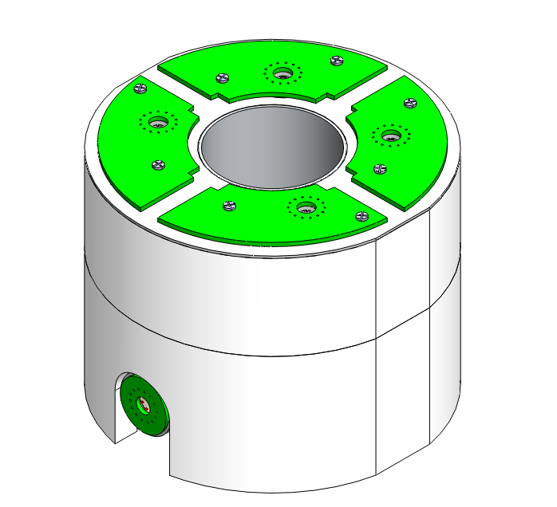
Top Anti coincidence shield

Slide 17
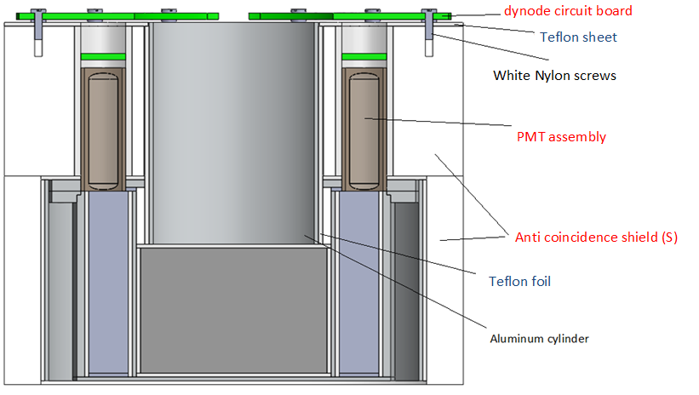
Anti coincidence shield – center cross section

Slide 18
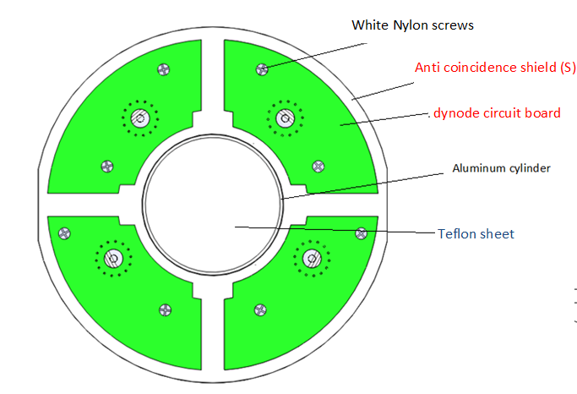
Top view
Anti coincidence shield - top view

Slide 19
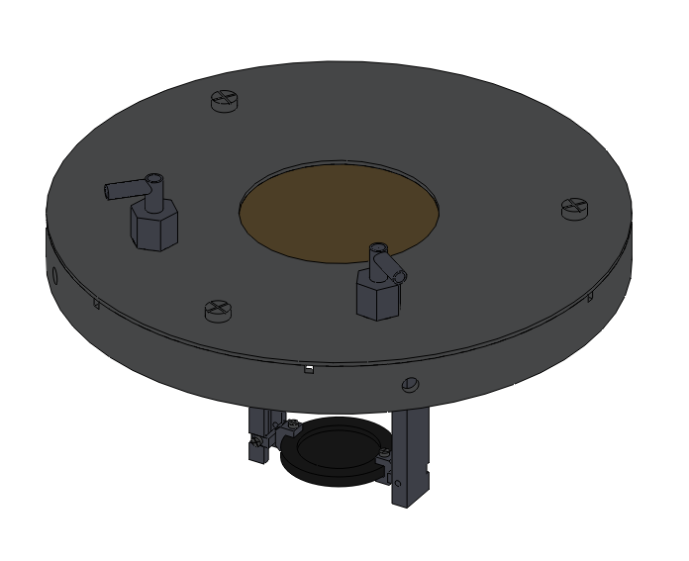
Cover assembly

Slide 20
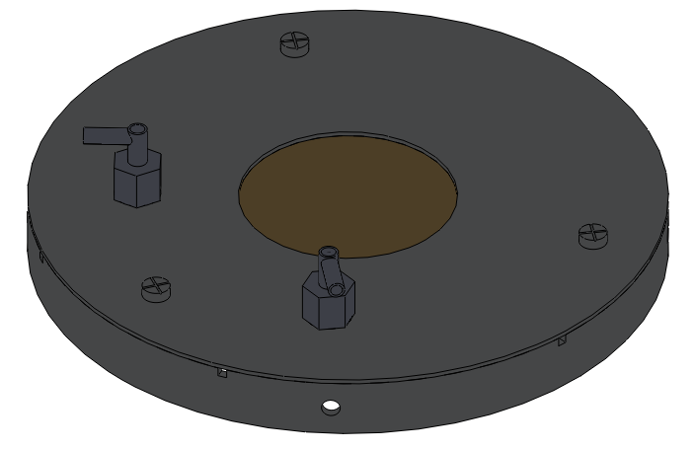
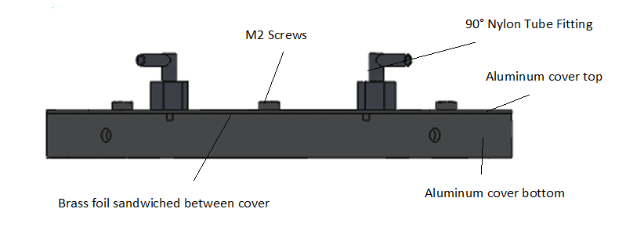
Cover and brass foil
Cover and brass foil - side view

Slide 21
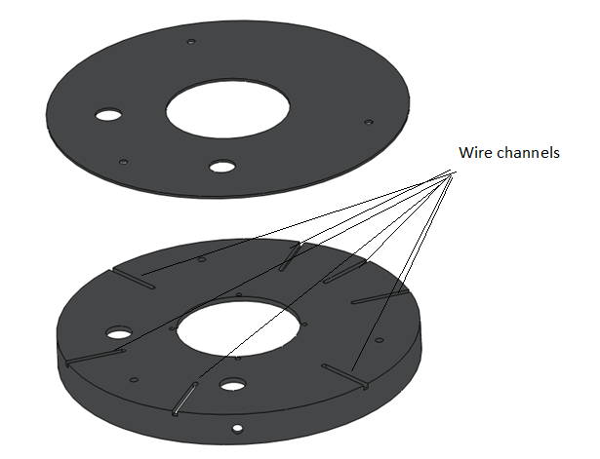
Cover - exploded view

Slide 22
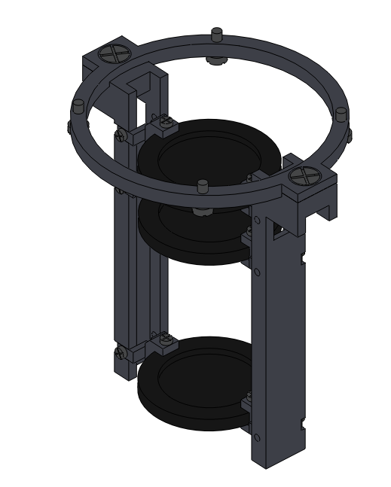
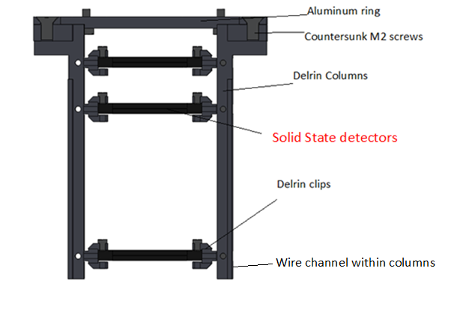
Solid state detector column assembly
Center Cross section

Slide 23
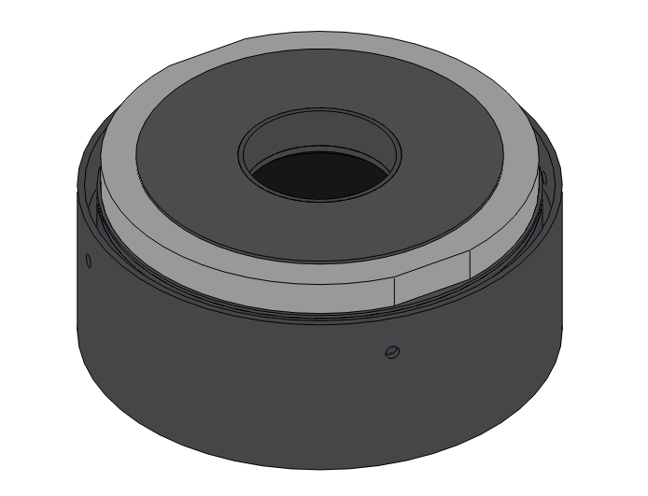
Base Assembly

Slide 24
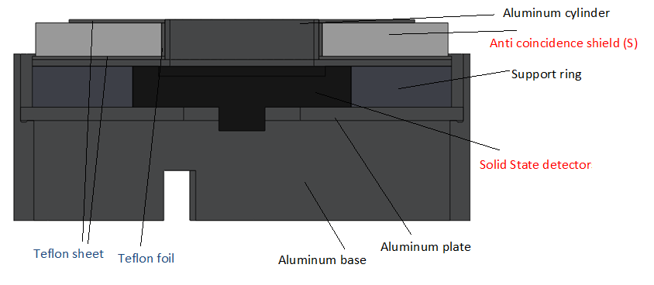
Base Assembly - center cross section

Slide 25
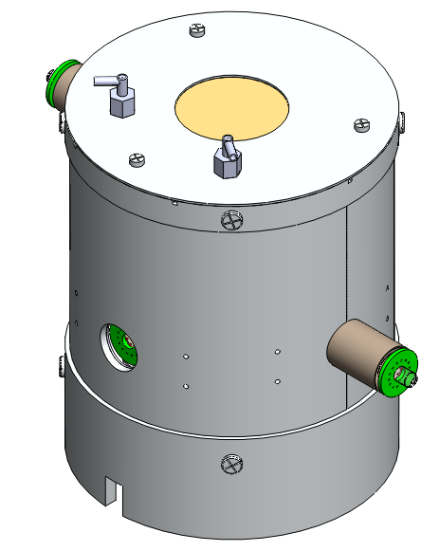
Cylinder assembly

Slide 26
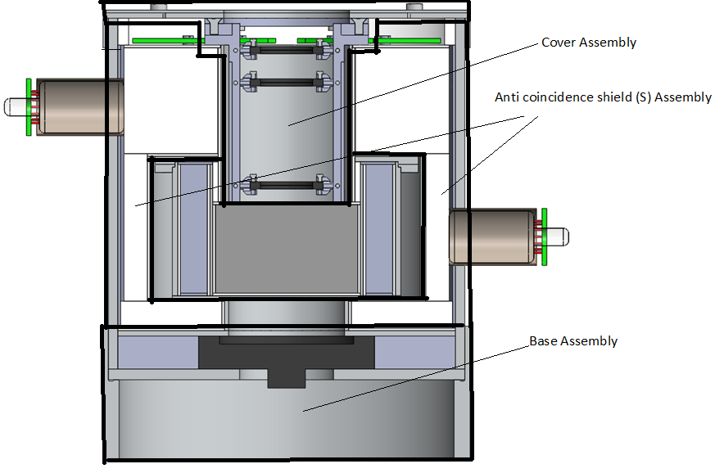
Cross section
Cylinder assembly - center cross section

Slide 27
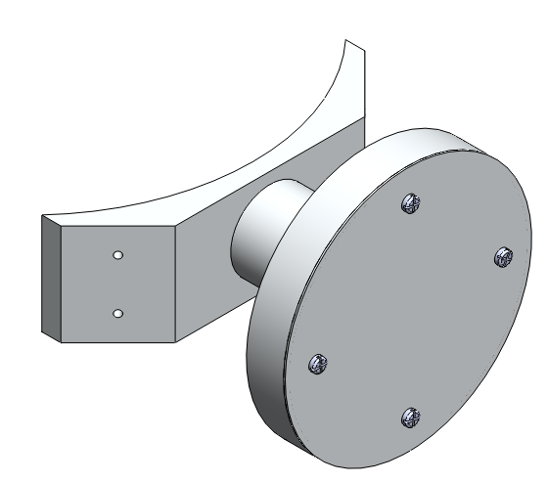
Photomultiplier tube support assembly

Slide 28
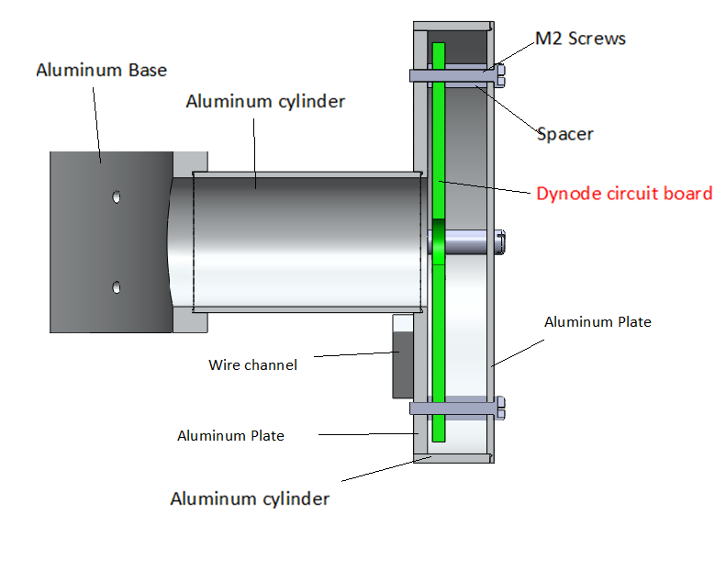
Top view
Photomultiplier tube support assembly – Center cross section

Slide 29
Final assembly

